Slide 1

How to build a
Winning Robot
By Brian Corteil

Slide 2
Only 198 Days to
Pi Wars!!!
Don't Panic!

Slide 3
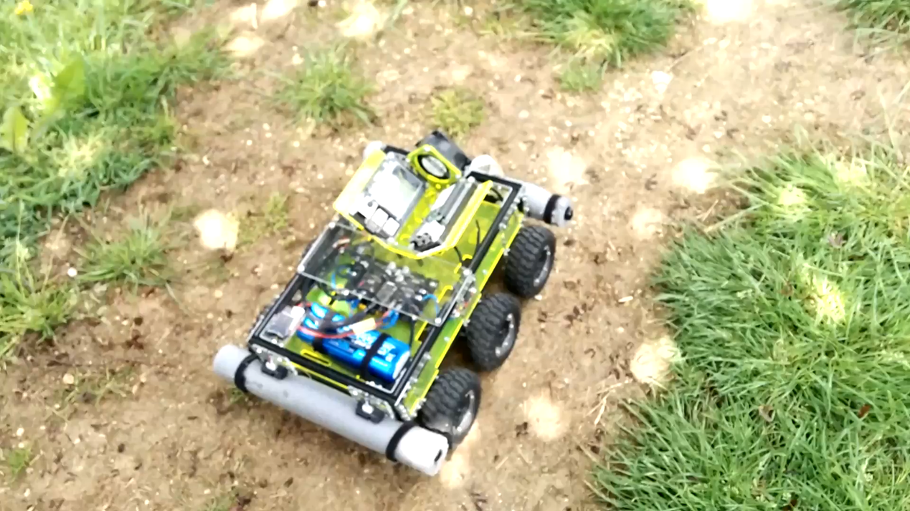
Revenge Pi Wars 2015 Winner (A3 Size)

Slide 4
First steps
What type of robot are you going to built
Which Raspberry Pi to use?
Kit or scratch build your own
Wheels or tracks
Motor selection
Battery type selection
Battery selection
Control method

Slide 5


A Spotter’s Guide to Robots
Image acquired from

Slide 6
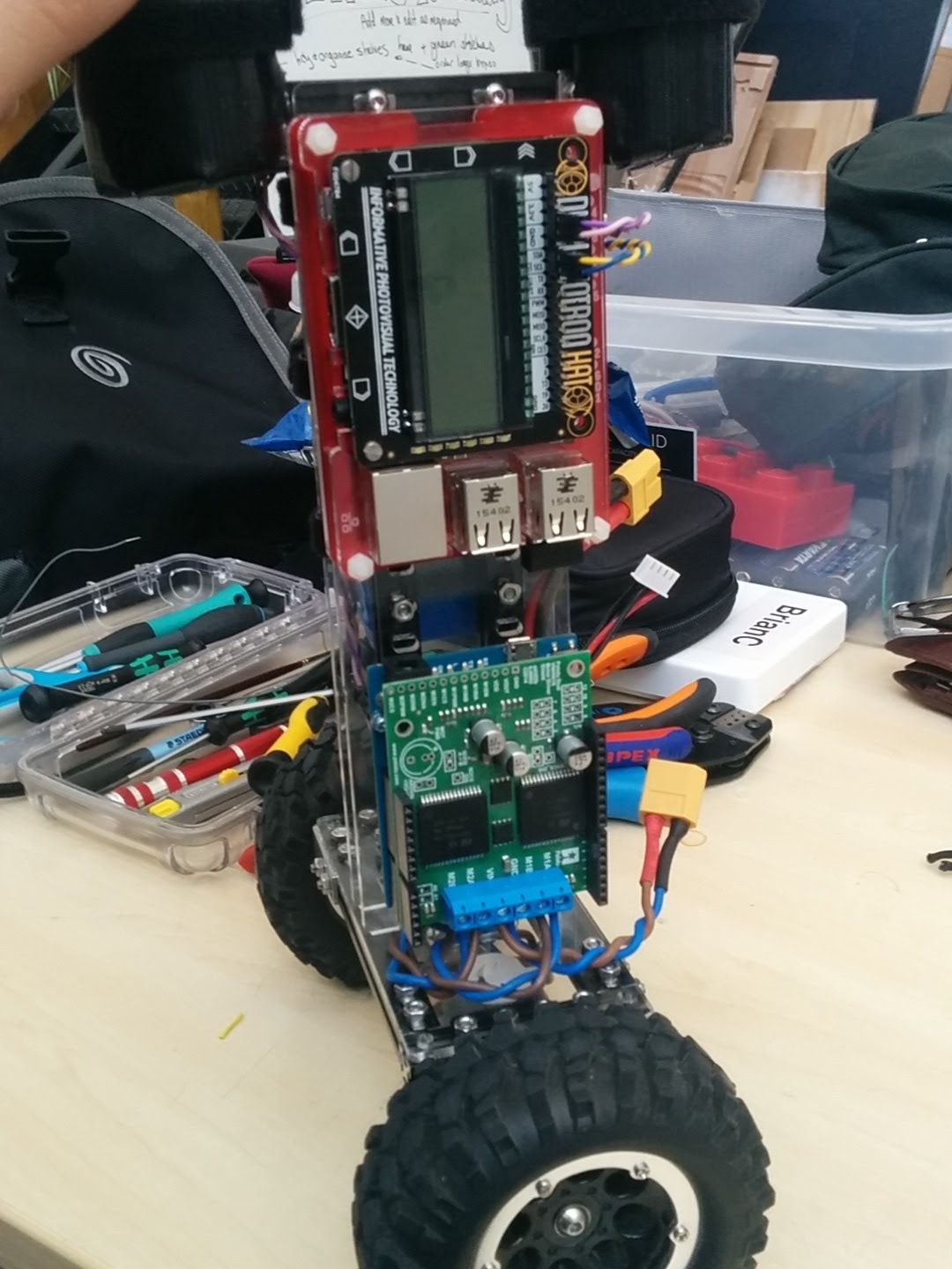
Balancing Robot

Slide 7
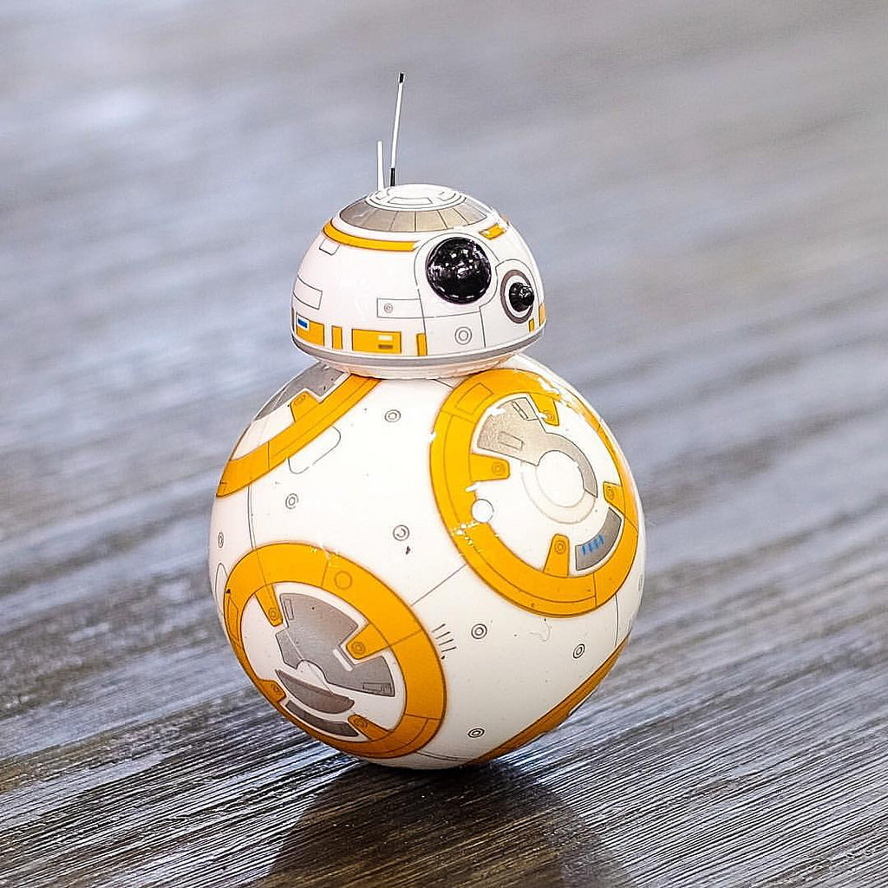
Ball Balancing Robot

Slide 8
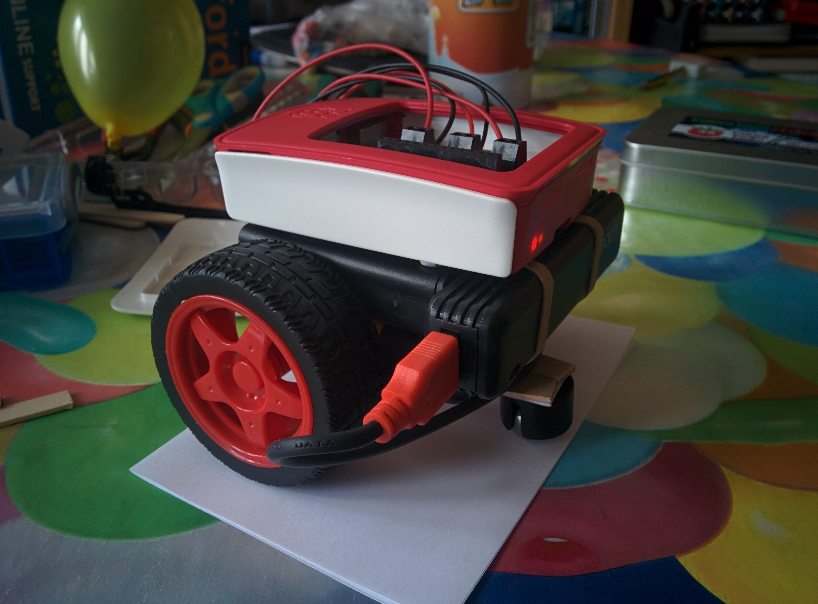
2 wheel drive tail drag/caster

Slide 9
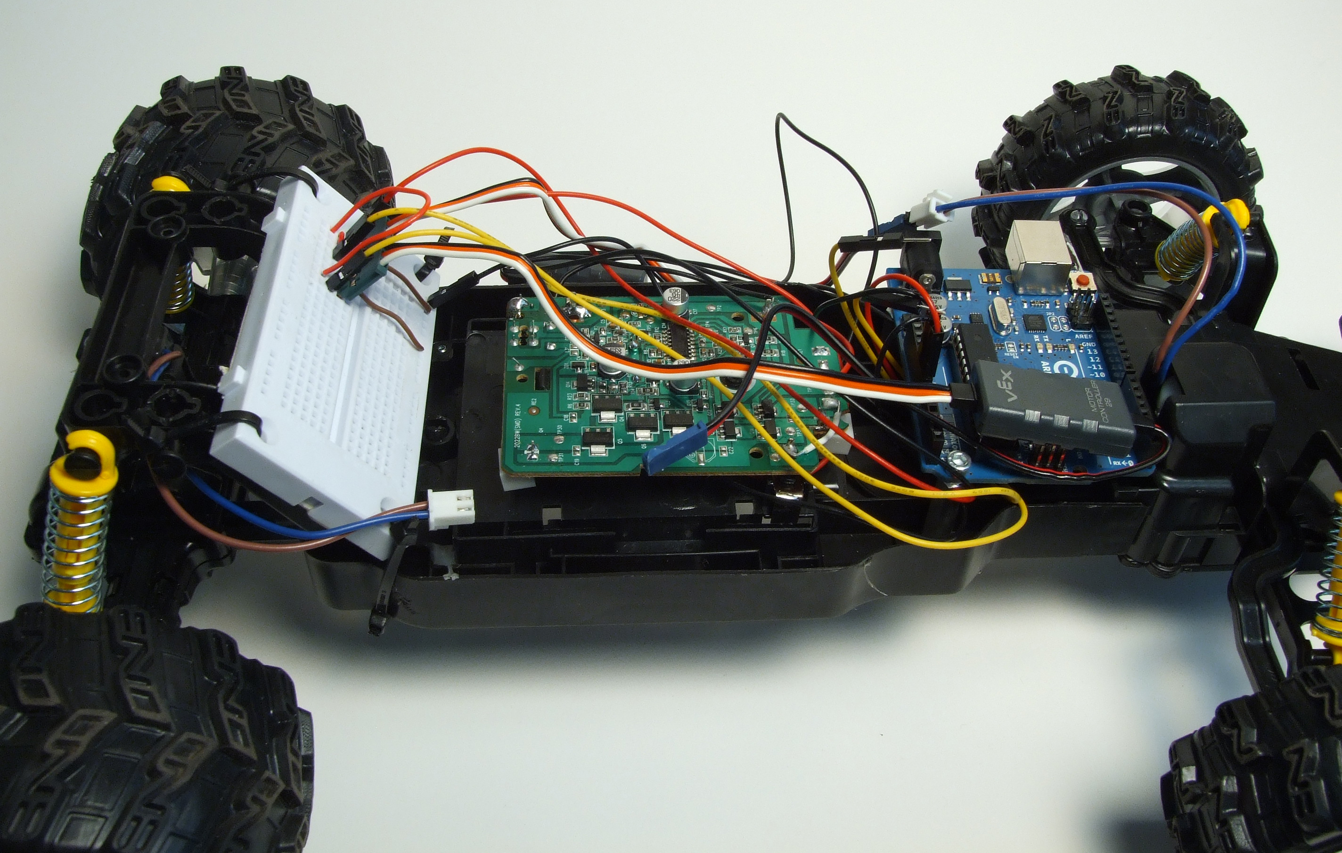
RC Car / Truck Conversion

Slide 10
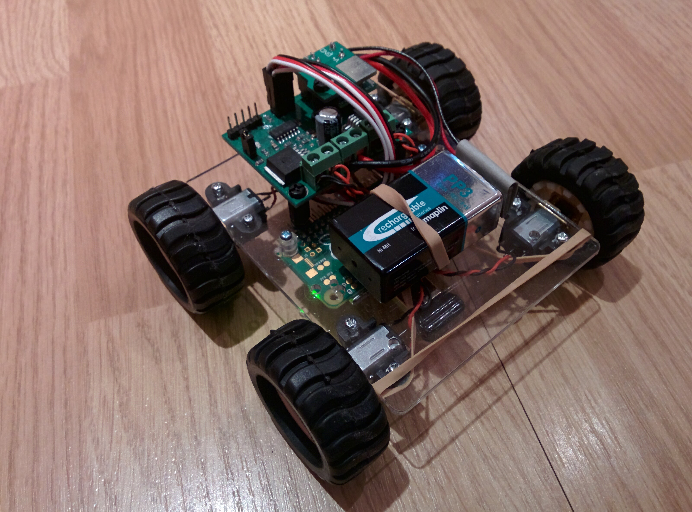
4 Wheel Drive

Slide 11
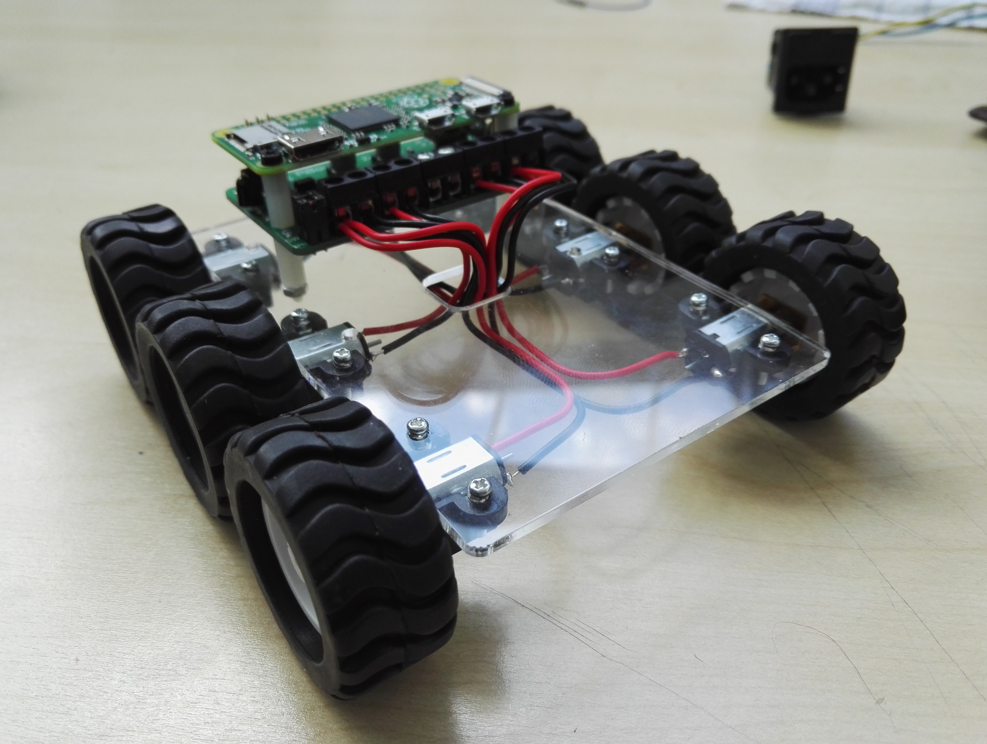
6 Wheel Drive

Slide 12
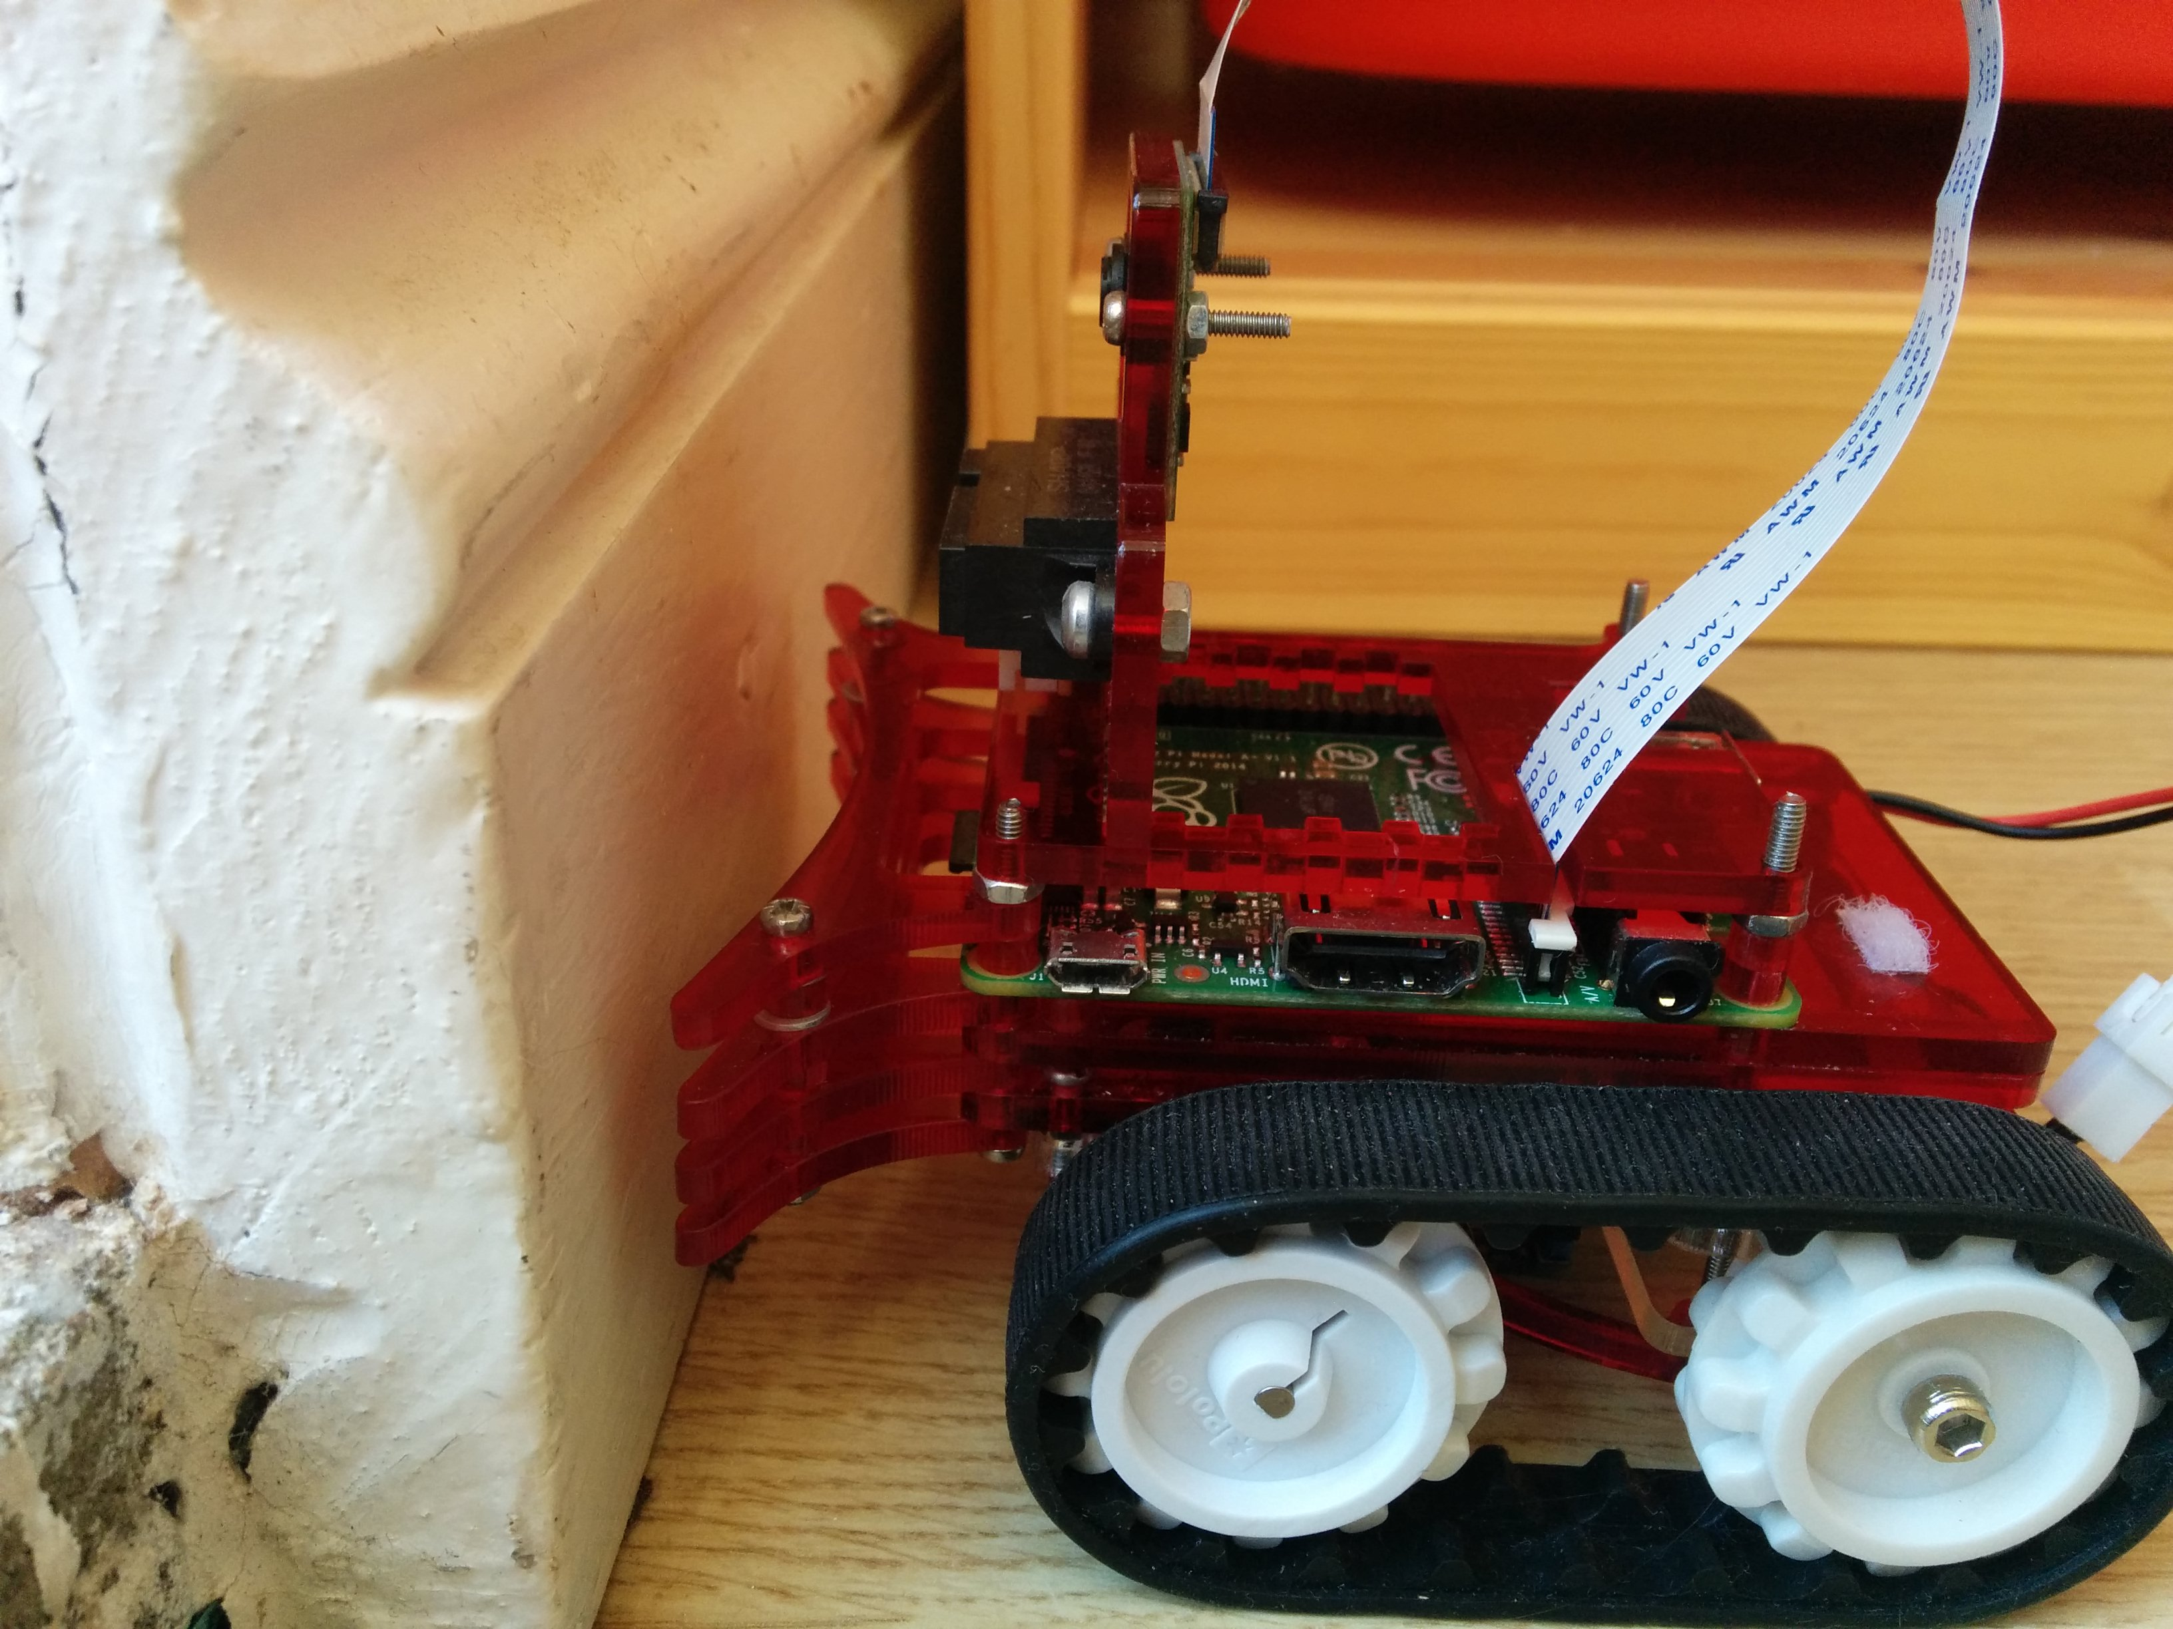
Tank Tracks

Slide 13
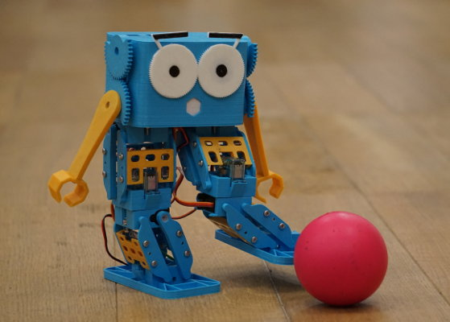
Walking Robot
Image stolen from www.robotical.io

Slide 14
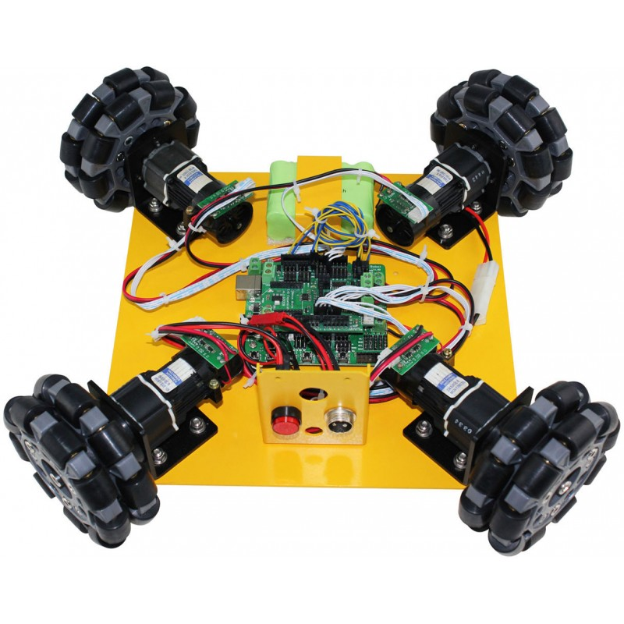
Omnidirectional Robot

Slide 15
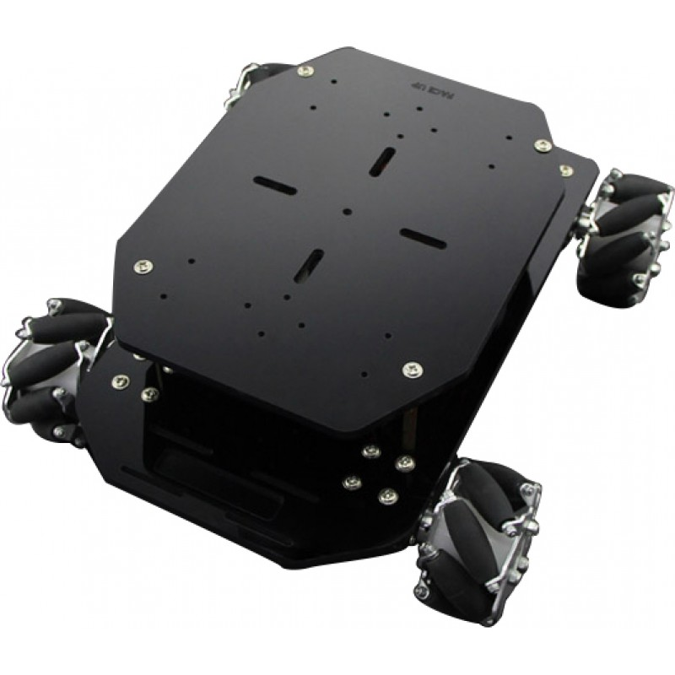
Mecanum Wheel Robot

Slide 16
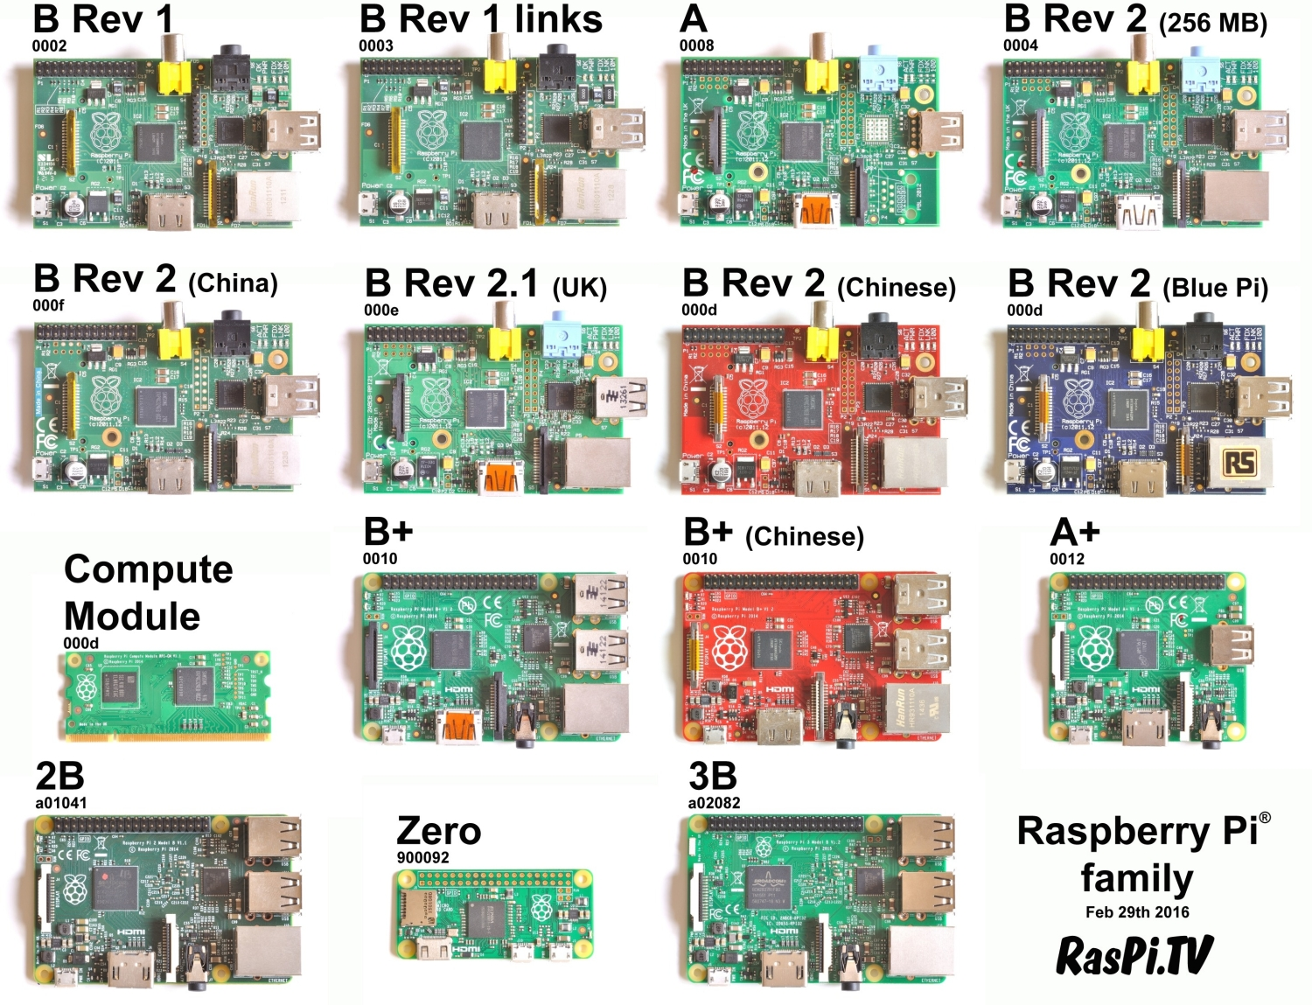
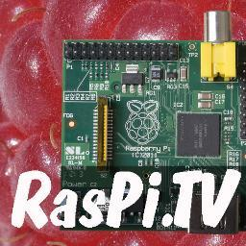
What Raspberry Pi is best for a Robot?
Image lifted from

Slide 17
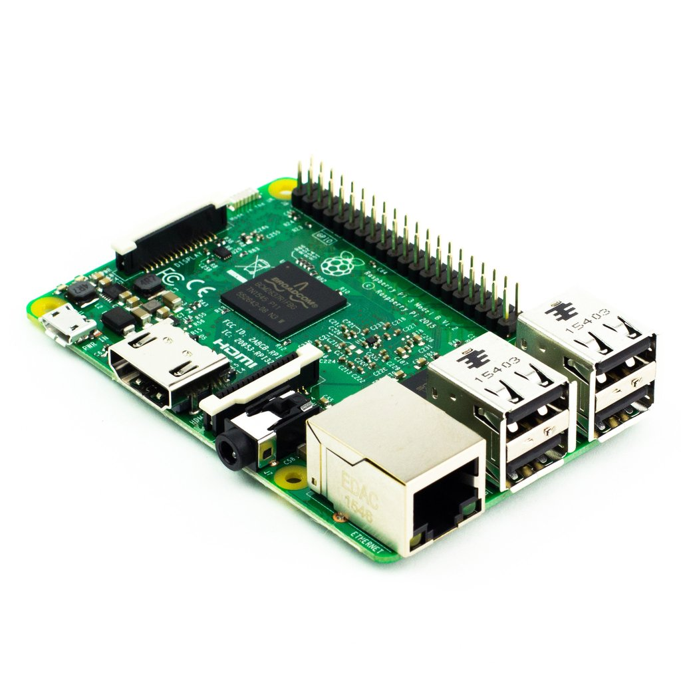
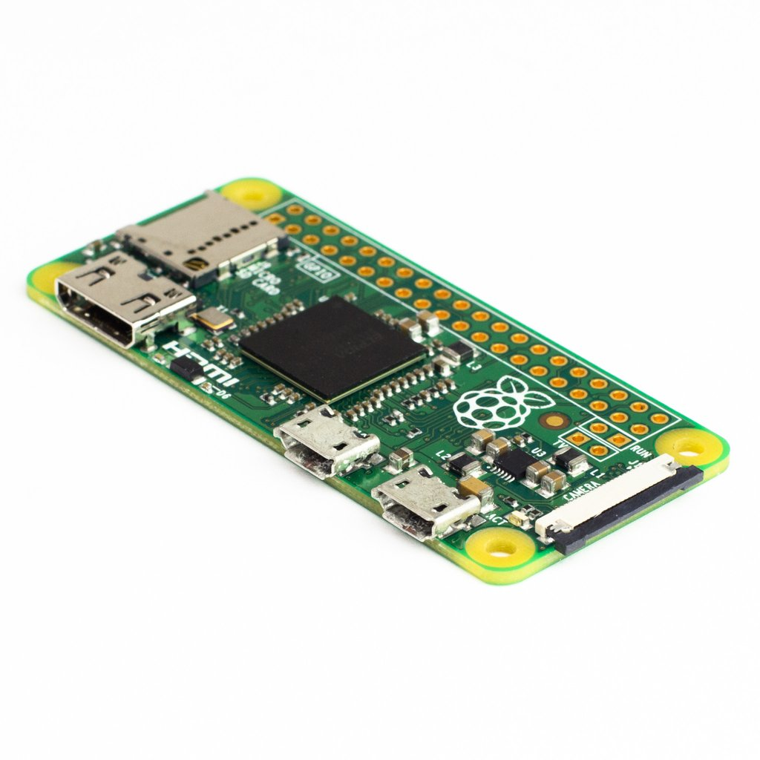

Pi Zero
Pi 3
Model | CPU cores | Speed | Memory | USB ports | Wi-fi/Bluetooth | Power consumption | Best for?
Pi3 | 4 | 1.2GHz | 1 GB | 4 | Yes | 230 mA | CV, multitasking, 4 USB ports, CPU speed
Zero | 1 | 1 GHz | 512 MB | 1 (OTG) | No | 100 mA | Cost, Size, low Power
*Wild card for the A+ if it gets an update with Bluetooth & Wi-Fi
Images nicked from

Slide 18
Wheels or tracks?

Slide 19
The Chassis
Most important thing, it holds your robot together
What do I build it out off?
Get the motors, wheels, motor driver and battery fitted on the chassis first.
Start driving ASAP!!!!
Test it Give it to someone to drive (break), who is not part of your team to test drive, they will find the kinks in your build.
200 school kids, is a good test group.

Slide 20
Big Meaty Motors

Slide 21
Motors Types
Brushless Pros: no brushes to ware out, more torque, more power, better control, power to size ratio Cons: less rugged, complex & expensive controls, cost
Brushed
Pros: high torque at lower speeds, simple control circuits, cost Cons: shorter operational life, power to size ratio
Stepper Pros: precise control (turns in small steps) Cons: complex controls, cost, slow

Slide 22
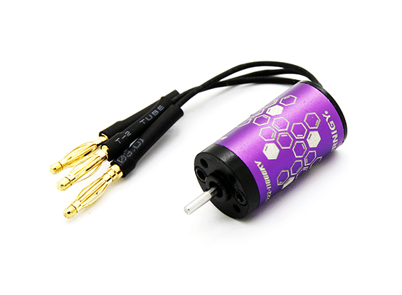
Brushless Motor

Slide 23
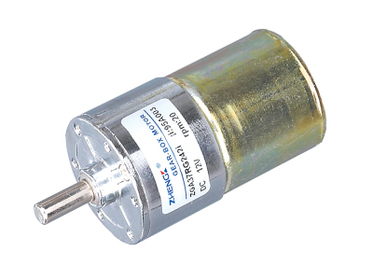
Brushed Motor

Slide 24
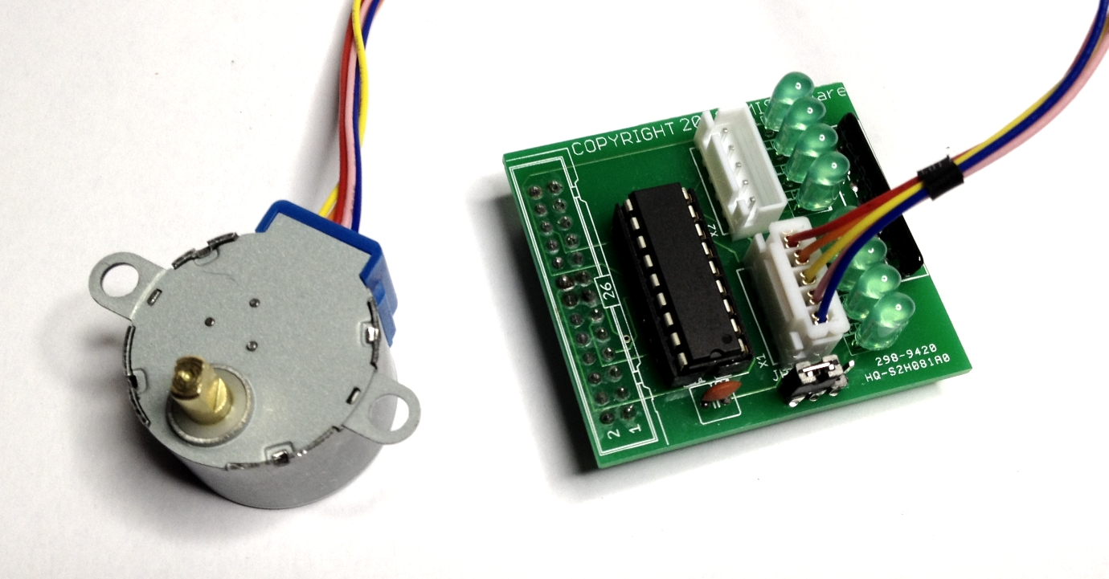

Stepper Motor
Image pinched from

Slide 25
What Do The Markings On The Motor Mean?
rpm: Revolutions Per Minute. Can also be shown as r/min. The lower the number the slower the motor is. E
Example: 500 rpm is faster than 25 rpm.
DC:12v The rated voltage of the motor, can also be shown as 12v dc. DC means that the motor must be power by a direct current source like a battery.
Gear box ratio: If a motor output is described as a ratio, the lower the number the faster the motor.
Example: 50:1 is faster than 254:1

Slide 26
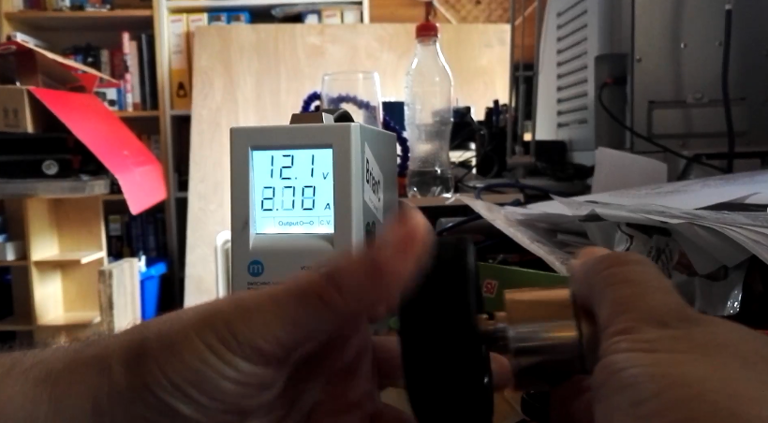
Motor Stall Current

Slide 27
Motor Controllers
Max peak current how much current the driver will tolerate before releasing magic smoke.
Drive voltage voltage, you can drive the motor(s)
Drive Current consent current the driver chip can maintain.
Logic Voltage voltage, the logic must be driven to function
Logic Current current, required to function

Slide 28
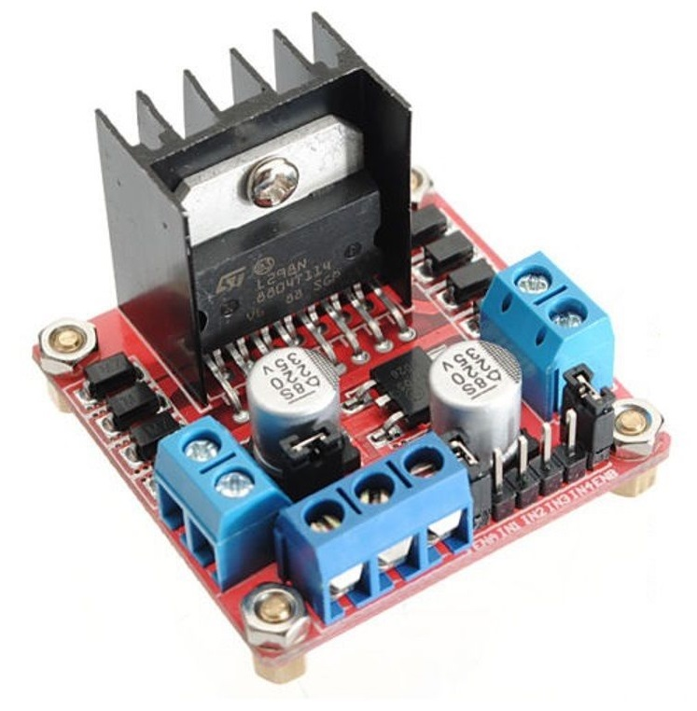
L298N

Slide 29
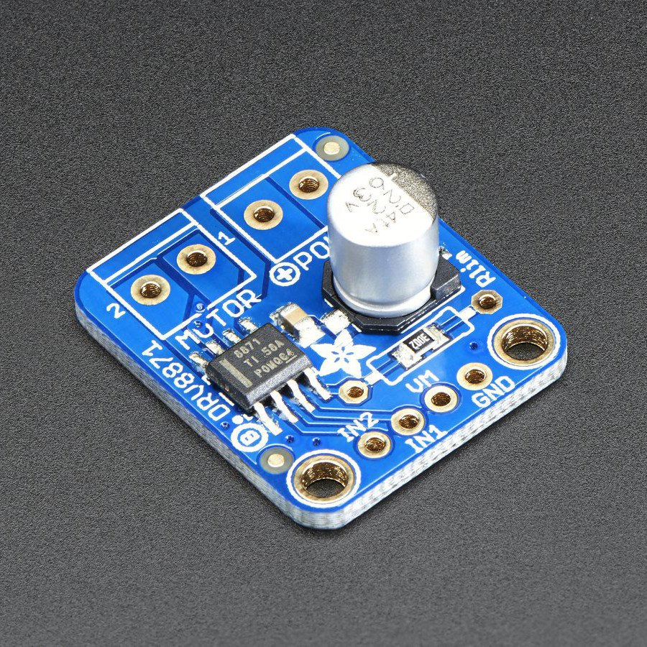
Adafruit DRV8871

Slide 30
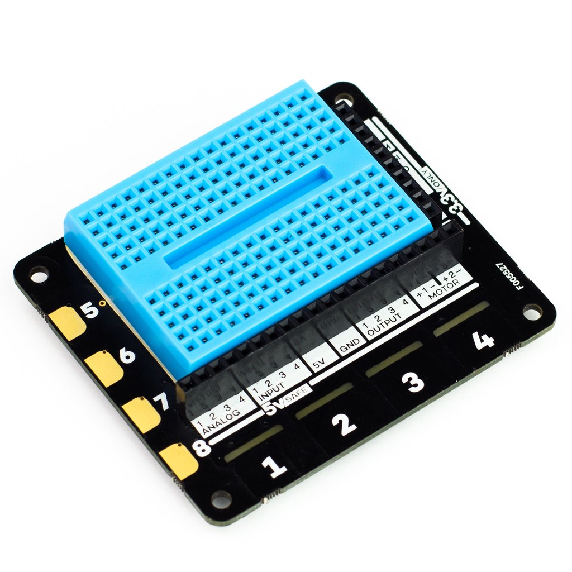
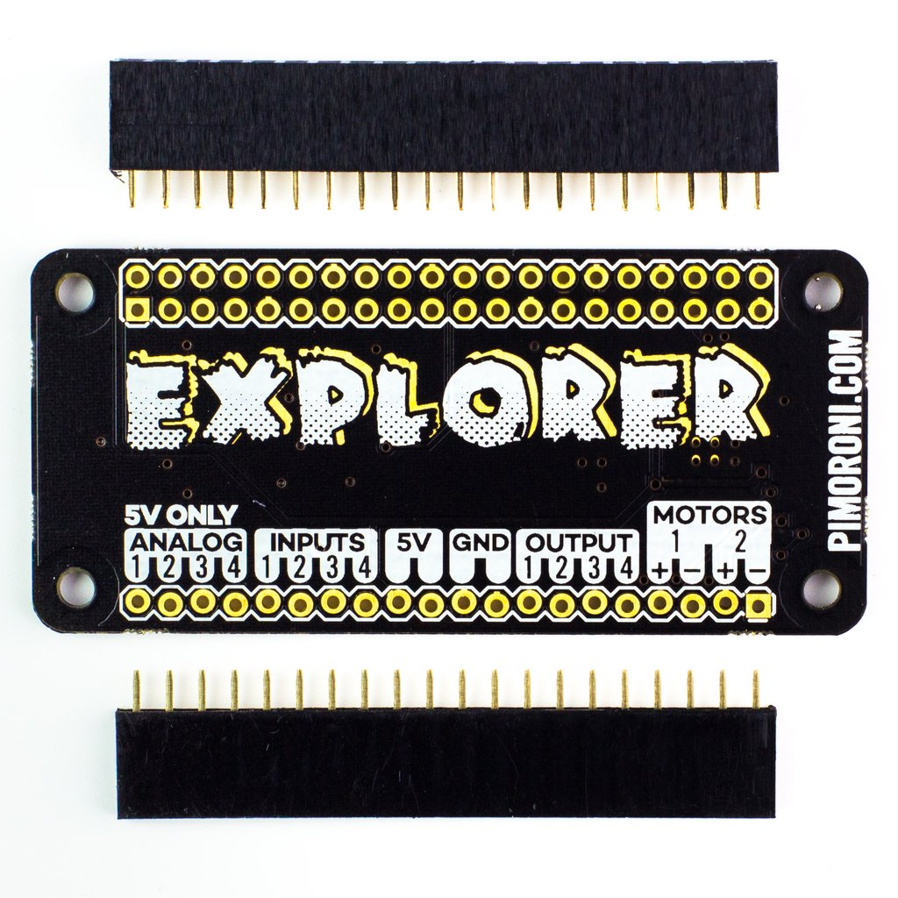
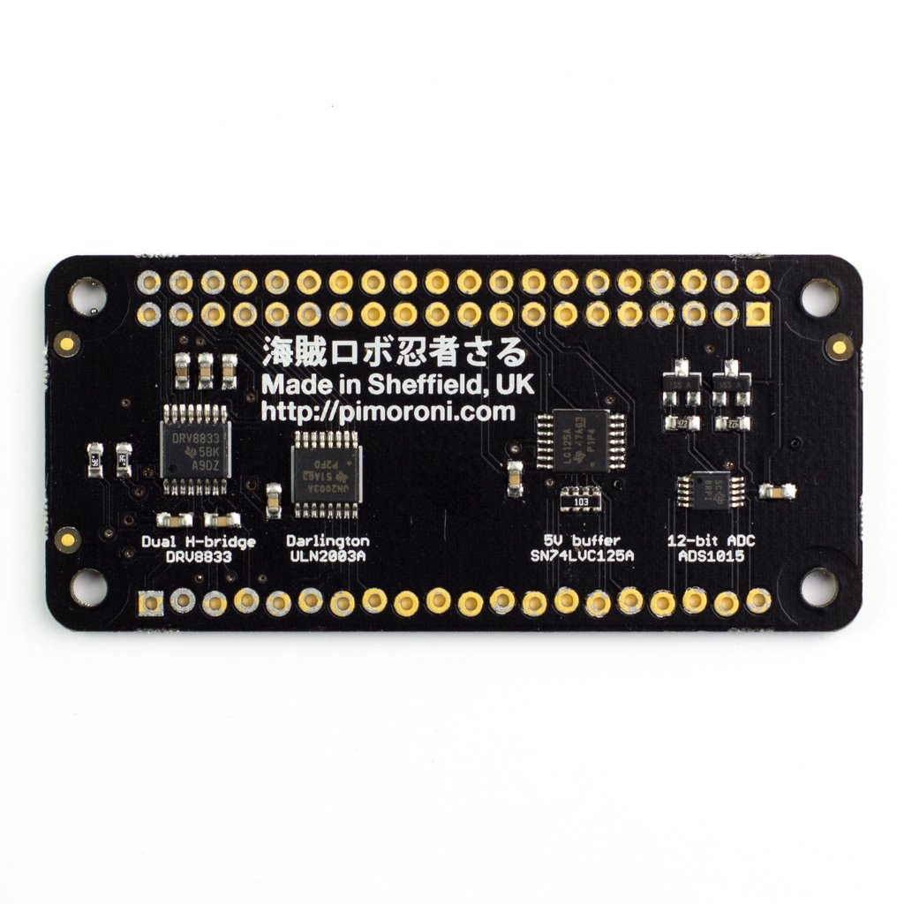
Explorer pHAT & Explorer hat pro

Slide 31
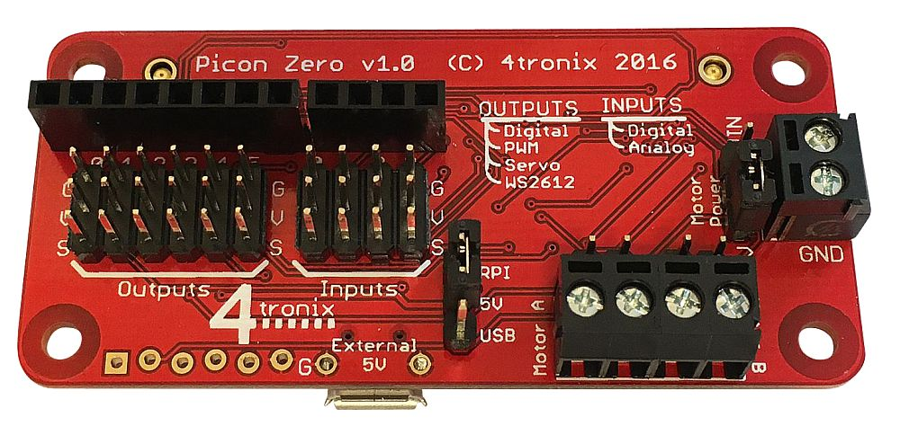
4tronix Picon Zero

Slide 32
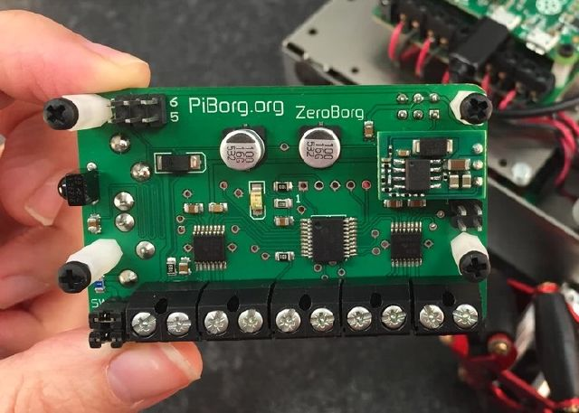
PiBorg ZeroBorg

Slide 33
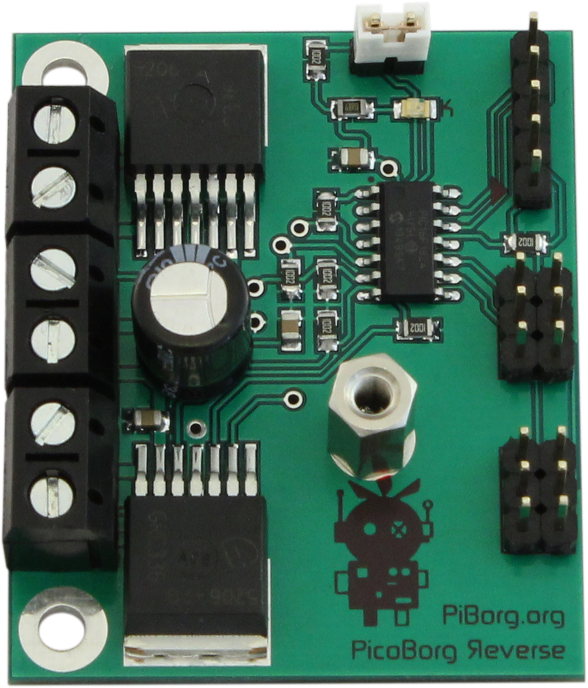
PiBorg Reverse

Slide 34
Batteries
Or how to make your life
interesting in all the wrong ways!

Slide 35
Rule Zero:
Don't be on fire!

Slide 36
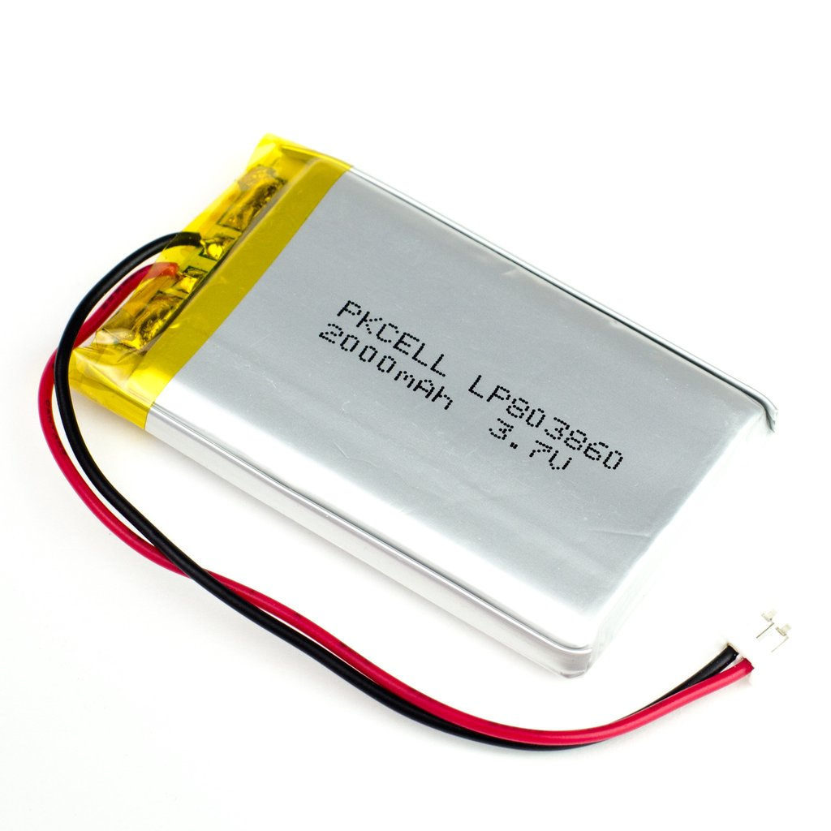
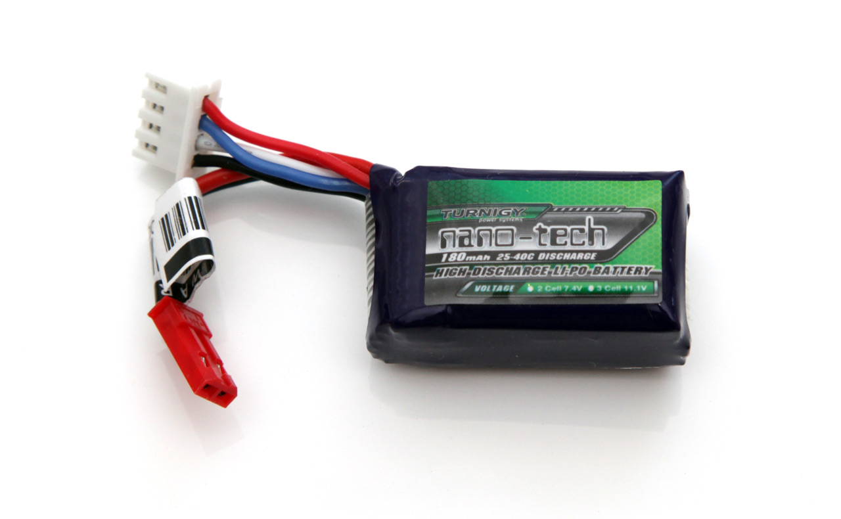
LiPo

Slide 37
Battery Types
LiPo there are two types of LiPo Type 1: built in safety circuits Type 2: no safety circuits!
NiCad or NiMH
Lead Acid
More information
https://en.wikipedia.org/wiki/List_of_battery_types

Slide 38
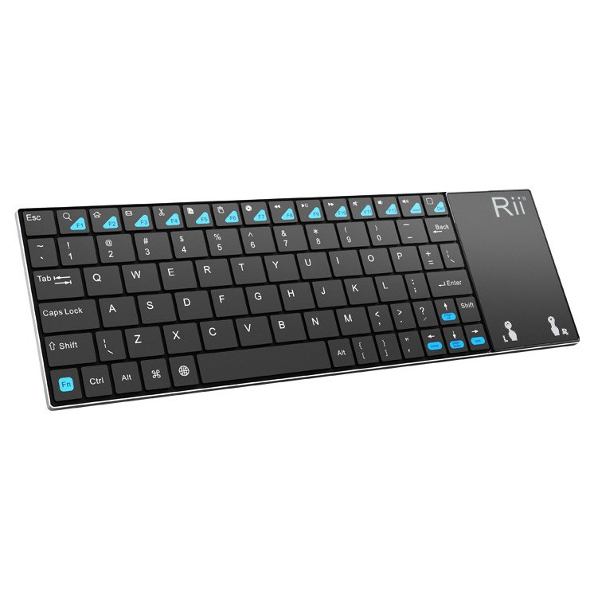
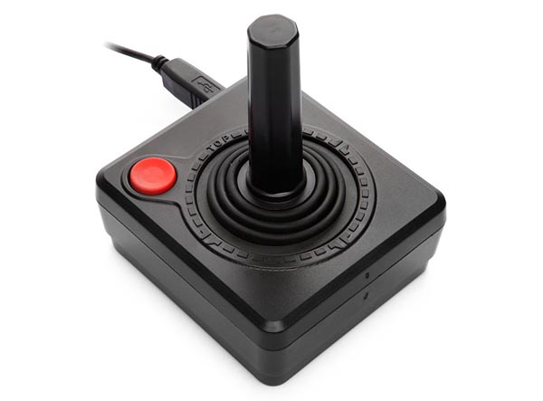

Control Methods

Slide 39
Make sure you drive your robot as often as possible!

Slide 40
User Interface
Display
LEDs
Access point
Via SSH
Bluetooth
WiFi

Slide 41
KISS
(keep it simple silly)

Slide 42
Sensors
Distance
IR
ToF
Sonic
Wheel/motor Encoders
Line following
Camera
IMU
What the Arduino for?
Use an Arduino where it makes sense, to off load time critical functions from the Raspberry Pi
Eg Analog to Digital conversion, keeping track of encoders, and other sensors

Slide 43
Useful Software
Py Charm Pro – great programming aid, there is a free version.
Inkscape – CAD
Open CAD – CAD
360 vision – 3D
Putty –SSH client
Filezilla – FTP client
Github – code bank

Slide 44
Steal your code (stand on the shoulders of giants)
Use and modify other peoples code
GPIO zero
Steal your code (github)
Stand on the shoulder of giants
Create your own libraries – reuse code were possible ie: maze and speed challenges both use distance sensors
Join the Pi Wars – unofficial forum, ask questions! Search Google Groups for Pi Wars

Slide 45
Make sure you drive your robot as often as possible!

